Slide 1
A I D A
AI-based Digital Assistant

Slide 2


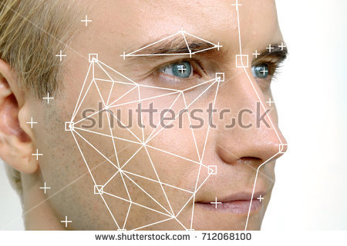
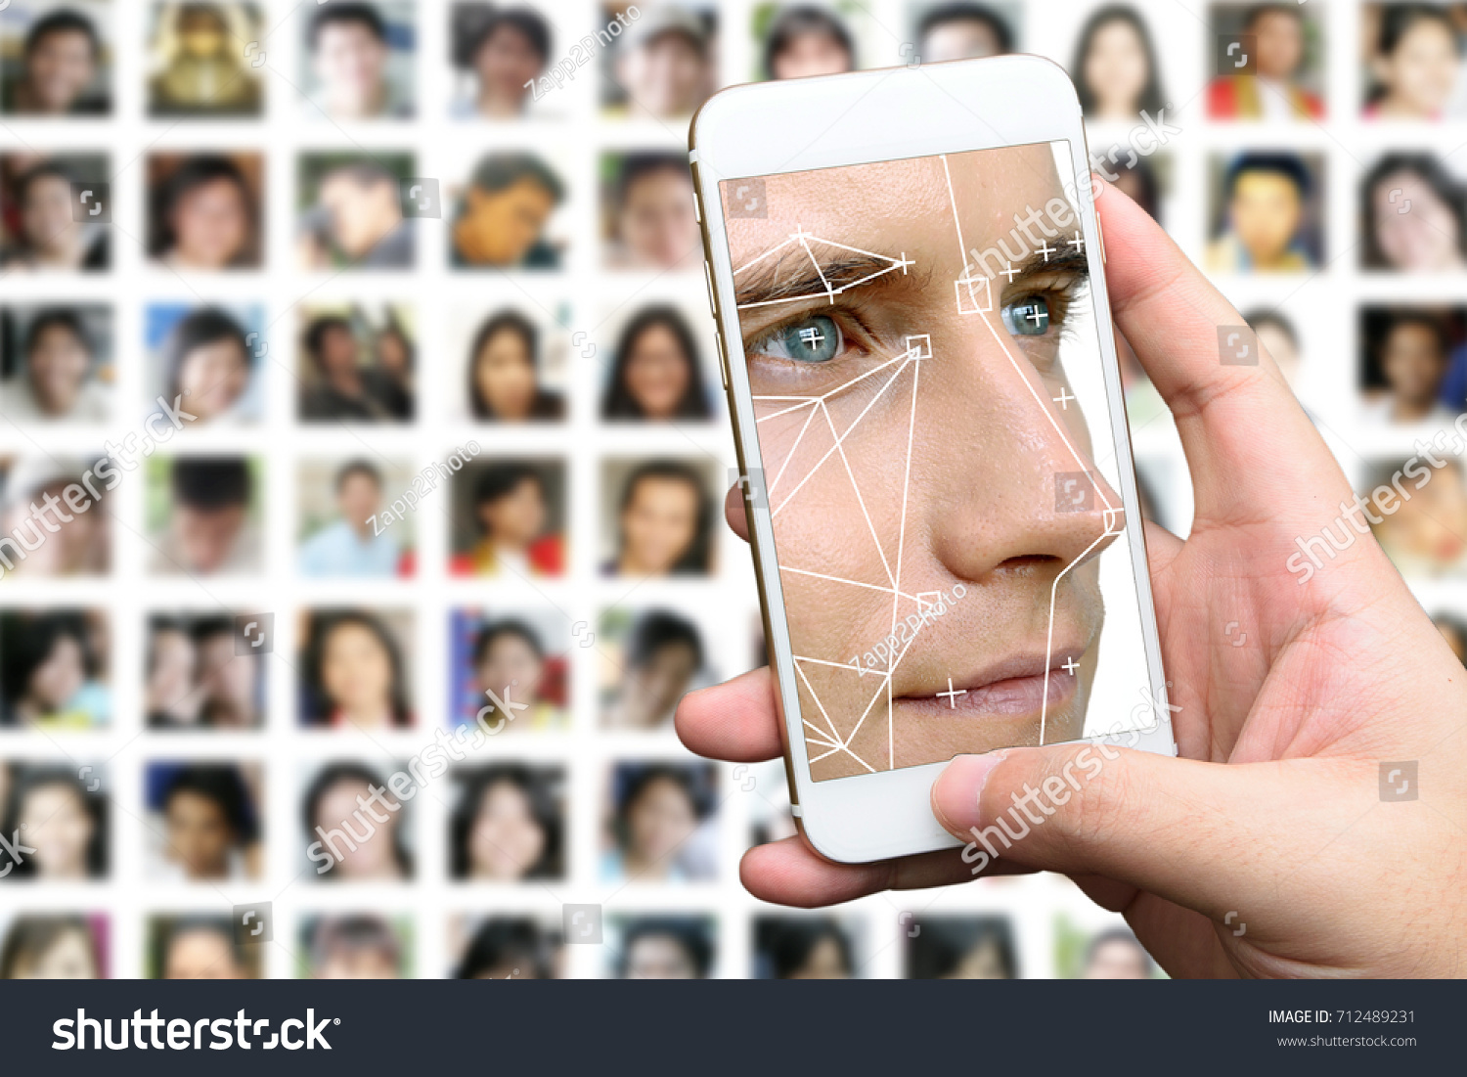
...
AIDA
Powered by
awaiting Alexa command
Search by image
Learning images
Provide an image to get the closest match
Results
images ready for processing
No logs generated yet
Memory
11
GB
0
16
Bandwidth
70
Mbps
0
100
Disk I/O
40
Mbps
0
100

Slide 3
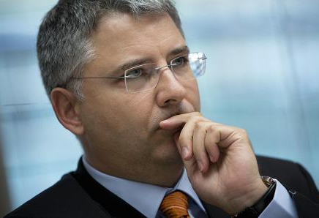
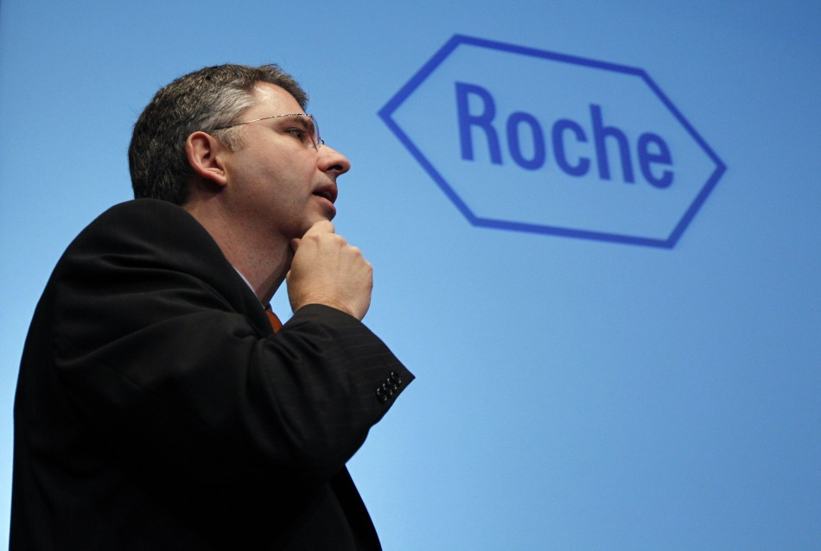
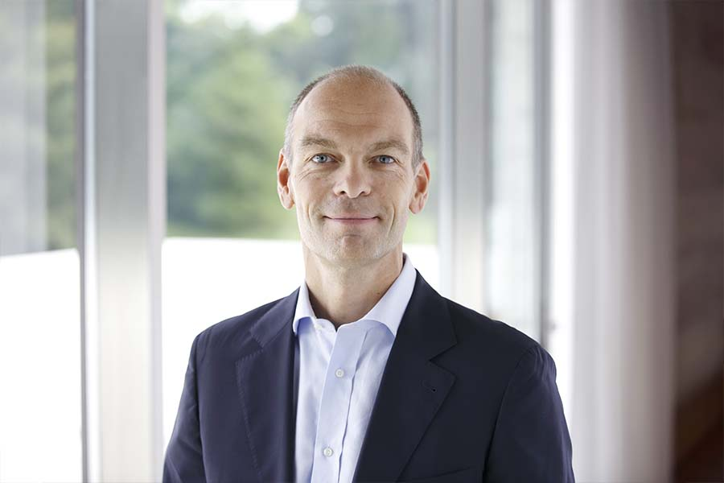
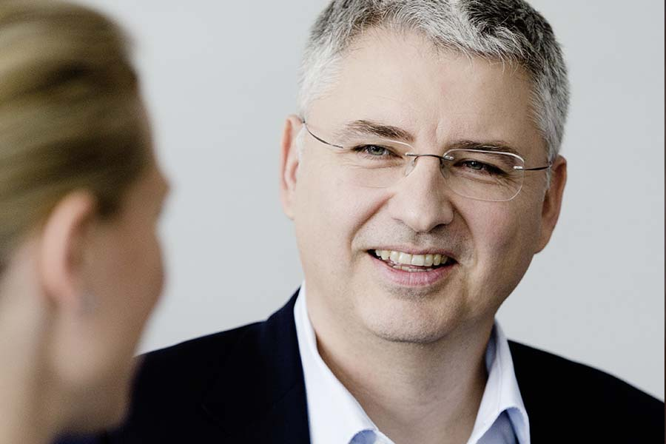

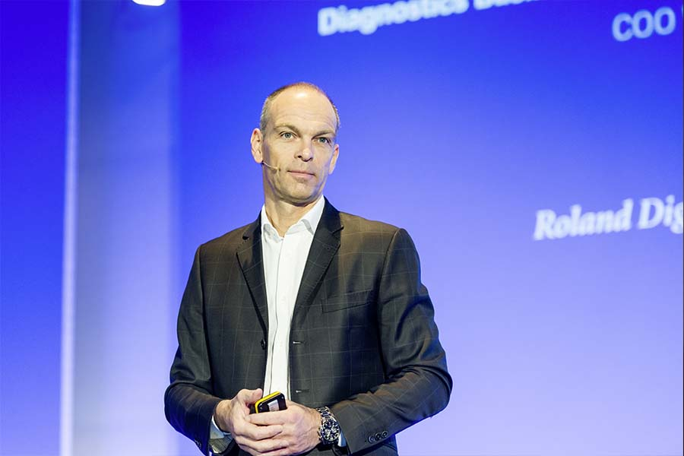
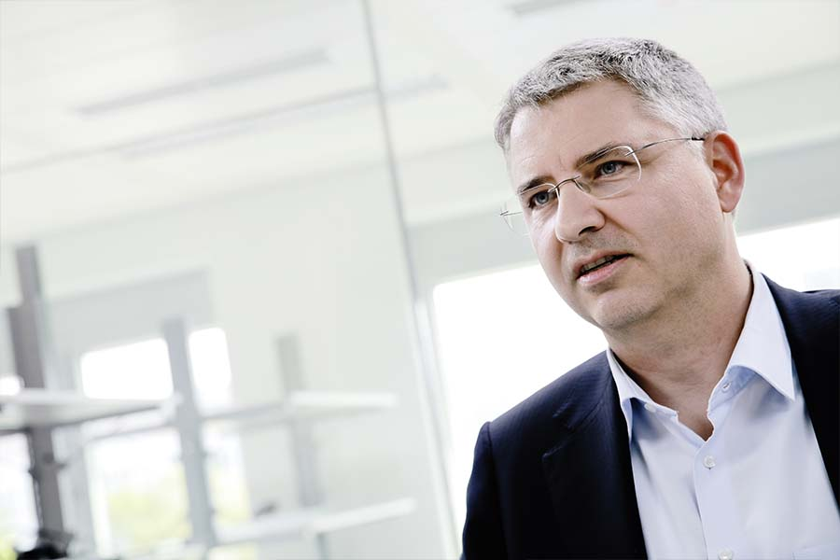
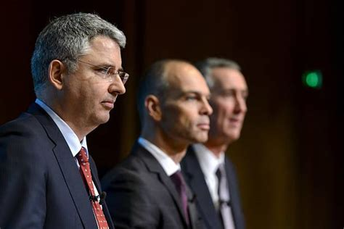
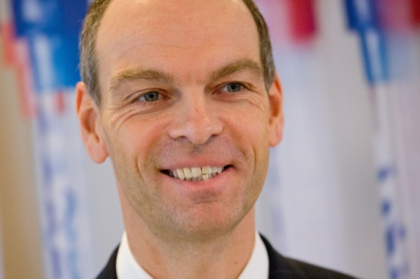
AIDA
Powered by
“Alexa, Learn images”
Search by image
Learning images
...
Provide an image to get the closest match
Results
processing images to learning
1 to 12
Memory
11
GB
0
16
Bandwidth
70
Mbps
0
100
Disk I/O
40
Mbps
0
100

Slide 4
AIDA
Powered by
awaiting Alexa command
Search by image
Learning images
Provide an image to get the closest match
Results
[Mon Apr 23 2018 19:23:18 GMT 0000 (UTC)]
New image received
processing images to learning
1 to 12
Memory
11
GB
0
16
Bandwidth
70
Mbps
0
100
Disk I/O
40
Mbps
0
100

Slide 5
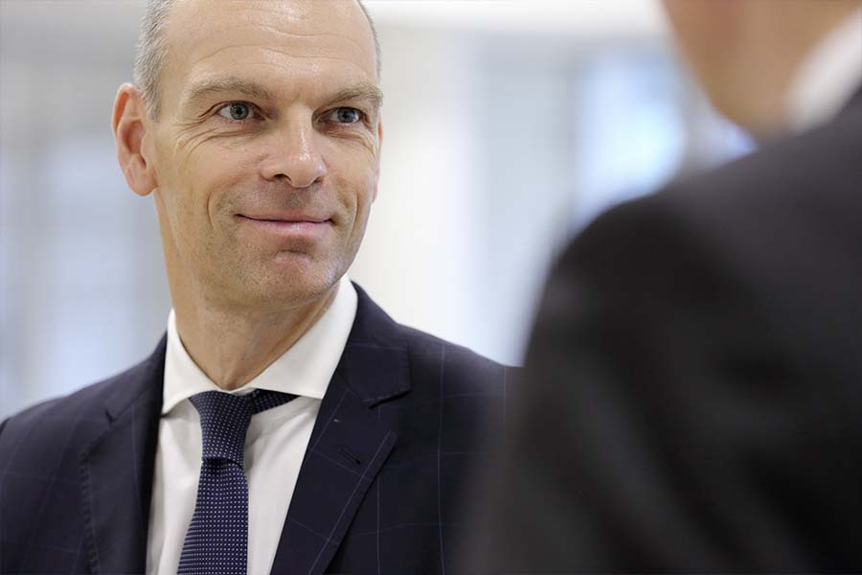
AIDA
Powered by
awaiting Alexa command
Search by image
Learning images
Provide an image to get the closest match
Results
[Mon Apr 23 2018 19:23:18 GMT 0000 (UTC)]
processing images to learning
1 to 12
Memory
11
GB
0
16
Bandwidth
70
Mbps
0
100
Disk I/O
40
Mbps
0
100

Slide 6
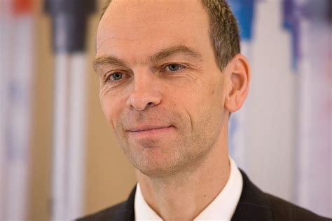
AIDA
Powered by
“Alexa, ask AIDA to identify the person”
Search by image
Learning images
...
Provide an image to get the closest match
Results
performing face match
[Mon Apr 23 2018 19:23:18 GMT 0000 (UTC)]
processing images to learning
1 to 12
Memory
11
GB
0
16
Image Properties/Metatags
Sample parameters
Match condfidence: 80%
Male
Age: 30-40
Happiness Factor: 80%
Popularity Factor: 40%
Bandwidth
70
Mbps
0
100
Disk I/O
40
Mbps
0
100

Slide 7
AIDA
Powered by
awaiting Alexa command
Search by image
Learning images
Provide an image to get the closest match
Results
[Mon Apr 23 2018 19:23:18 GMT 0000 (UTC)]
[Tue Apr 24 2018 06:56:42 GMT 0000 (UTC)]
processing images to learning
performing face match
1 to 12
Memory
11
GB
0
16
Image Properties/Metatags
Sample parameters
Match condfidence: 80%
Male
Age: 30-40
Happiness Factor: 80%
Popularity Factor: 40%
Bandwidth
70
Mbps
0
100
Disk I/O
40
Mbps
0
100

Slide 8
AIDA
Powered by
awaiting Alexa command
Search by image
Learning images
Provide an image to get the closest match
Results
[Mon Apr 23 2018 19:23:18 GMT 0000 (UTC)]
[Tue Apr 24 2018 06:56:42 GMT 0000 (UTC)]
processing images to learning
performing face match
Memory
11
GB
0
16
Bandwidth
70
Mbps
0
100
Disk I/O
40
Mbps
0
100

Slide 9
AIDA
Powered by
“Alexa, deploy webapp or other command
Search by image
Learning images
Provide an image to get the closest match
Results
[Mon Apr 23 2018 19:23:18 GMT 0000 (UTC)]
[Tue Apr 24 2018 06:56:42 GMT 0000 (UTC)]
[Tue Apr 24 2018 08:54:30 GMT 0000 (UTC)] [Tue Apr 24 2018 09:05:12 GMT 0000 (UTC)]
processing images to learning
performing face match
deploying web application
sending notification on web application deployment
Memory
11
GB
0
16
Bandwidth
70
Mbps
0
100
Disk I/O
40
Mbps
0
100

